Slide 1
Adversarial Reasoning:
Sampling-Based Search with the
UCT algorithm
Joint work with
Raghuram Ramanujan and
Ashish Sabharwal

Slide 2
Upper Confidence bounds for Trees (UCT)
The UCT algorithm (Kocsis and Szepesvari, 2006), based on the UCB1 multi-armed bandit algorithm (Auer et al, 2002) has changed the landscape of game-playing programs in recent years.
  First program capable of master level play in 9x9 Go (Gelly and Silver, 2007)
  UCT-based agent is a two-time winner of the AAAI General Game Playing Contest (Finnsson and Bjornsson, 2008)
  Also successful in Kriegspiel (Ciancarini and Favini, 2009) and real-time strategy games (Balla and Fern, 2009)
  Key to Google’s AlphaGo success.

Slide 3
Understanding UCT
Despite its impressive track record, our current understanding of UCT is mostly anecdotal.
Our work focuses on gaining better insights into UCT by studying its behavior in search spaces where comparisons to Minimax search are feasible.

Slide 4
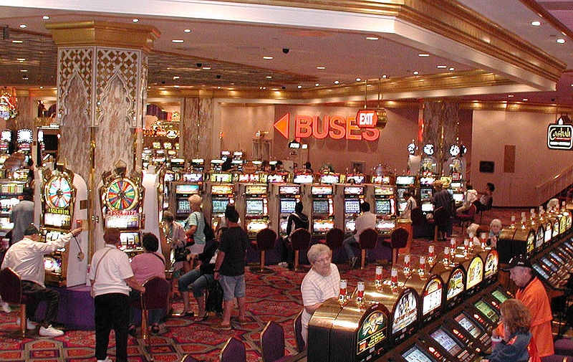
“Find the best slot machine”
--- while trying to make as much
money as possible

Slide 5
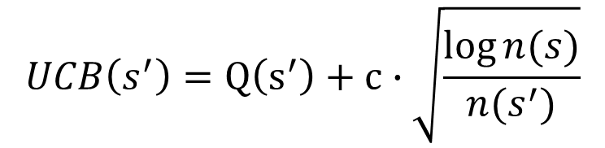
The UCT Algorithm
Thm: Non-optimal arms are
sampled at most
log(n) times!
Every node in the search tree is
treated like a multi-armed bandit.
“Find the best slot machine”
--- while trying to make as much
money as possible
Strategy?
What would you
want to prove?
s
The UCB score is computed
for each child and the best
scoring child is chosen for
expansion
s'
Estimated utility =
the average
payout of arm so far
Exploitation term
Q(s’) is the estimated utility of state s’
Exploration term
n(s) is the number of visits to state s

Slide 6
The UCT Algorithm
We descend the tree by starting at the root node and repeatedly
selecting the best scoring node
Incrementally grow game tree by creating “lines of play” from the top.
&
Update estimates of board values.
At the opponent’s nodes, a symmetric lower confidence bound is minimized to pick the best move
Node with unexplored child, a new child is created
A random playout is performed to
estimate the utility R (+1,0, or -1)
of this state
R

Slide 7
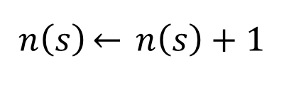
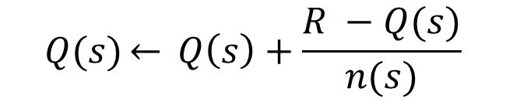
The UCT Algorithm
An averaging backup is used to update
the value estimates of all nodes on the
path from the root to the new node
R
R
Visit count update
R
R
State utility update
Select each child node based on UCB scheme.

Slide 8
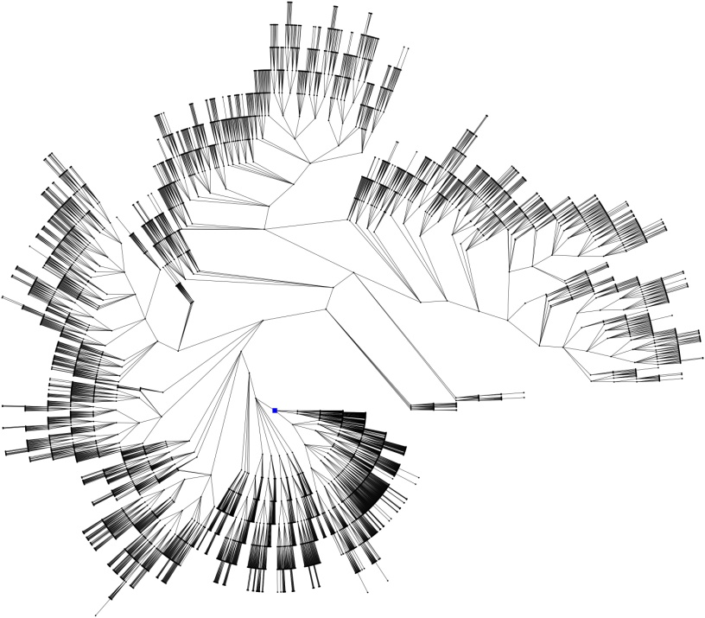
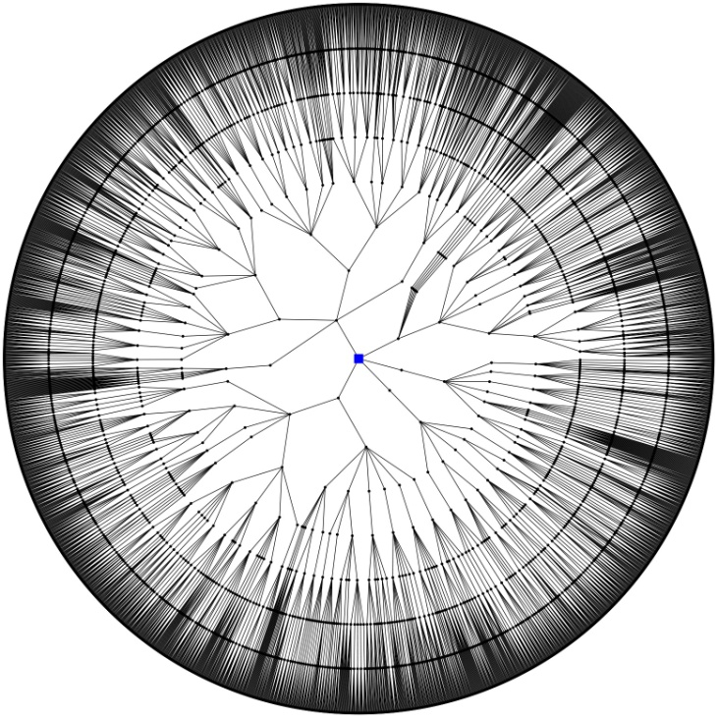
UCT versus Minimax
UCT Tree
Minimax Tree
Asymmetric tree
Best-performing method for Go
Full-width tree up to some depth bound k
Best-performing method for eg Chess

Slide 9
Search Spaces
Minimax performs poorly in Go due to the large branching factor and lack of good board eval
To understand UCT better, we need domain with another competitive method.
Considered domains where Minimax search produces good play
  Chess
    A domain where Minimax yields world-class play but UCT
    performs poorly
  Mancala
    A domain where both Minimax and UCT yield competent players ‘out-of-the-box’
  Synthetic games (ongoing work)

Slide 10
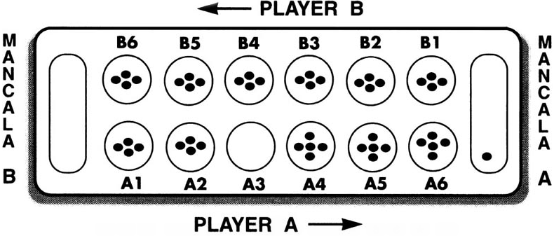
Mancala
Both UCT and Minimax search
produce good players.
pit
store
A move consists of picking up all the stones from a pit and ‘sowing’ (distributing) them in a counter-clockwise fashion
Stones placed in the stores are captured and taken out of circulation
The game ends when one of the sides has no stones left
Player with more captured stones at the end wins

Slide 11
UCT on Mancala
We examine the three key components of UCT
  Exploration vs. Exploitation
  Random playouts
  Info backup: Averaging versus minimax
Insights lead to improved UCT player
We then deploy the winning UCT agent in a novel partial game setting to understand how it wins

Slide 12
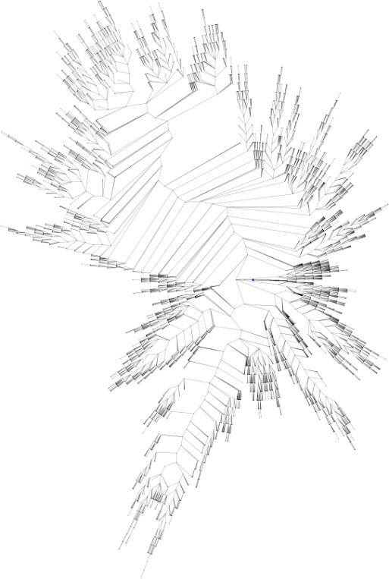
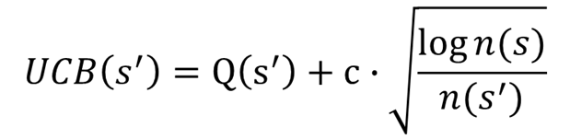
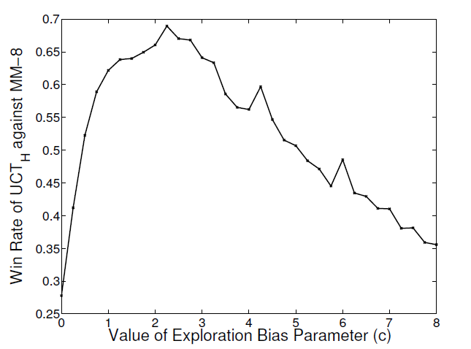


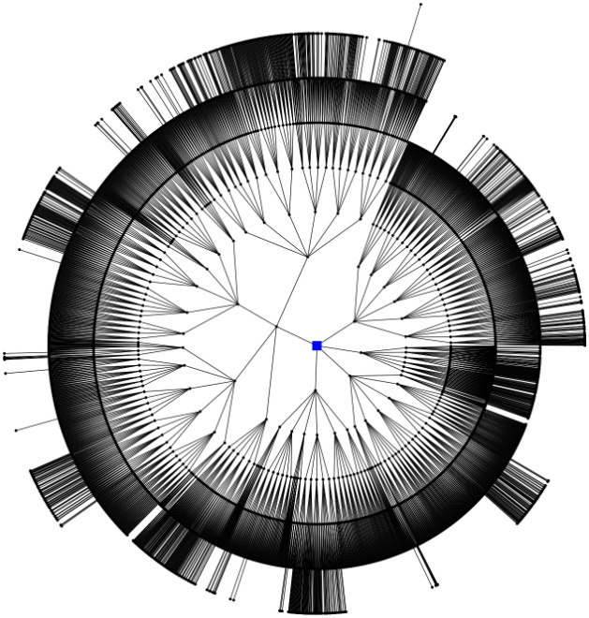
I) Full-Width versus Selective Search
Optimal setting for c
Vary the value of the exploration constant c and measure the win-rate of UCT against a standardized Minimax player

Slide 13
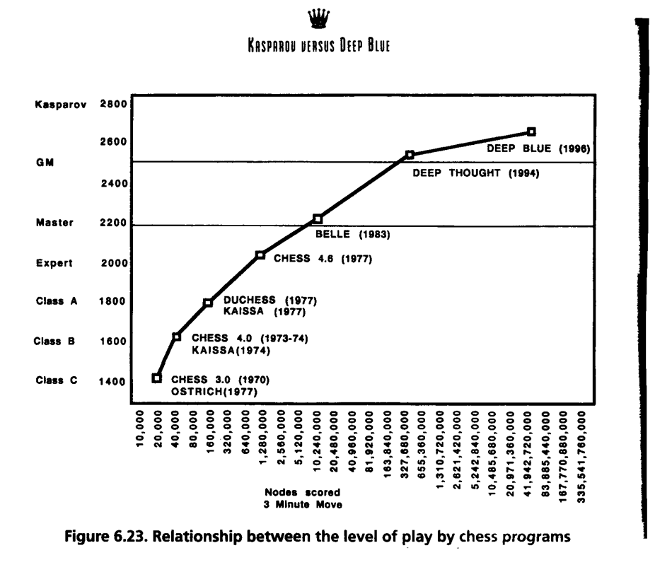



Previous experience game tree search: “full width” + selective extensions outperforms “trying to be smart in node expansion.”
Lesson: UCT challenges general notion that forward (i.e. unsafe) pruning is a bad idea in game tree search – not necessarily so! Smart exploration/exploitation driven search can work.

Slide 14
II) Random Playouts (Samples)
During search tree construction, UCT estimates the value of a newly added node using a “random playout” (resulting in a +1, -1, or 0).
Appeal: Very general. Don’t need to construct a board/state evaluation function.
But, random games look very different from actual games. Any real info in the result of random play?
A: Yes, but it’s a very “faint” signal. Other aspects of UCT compensate.
Also, how many playouts (“samples”) per node? (surprise)

Slide 15
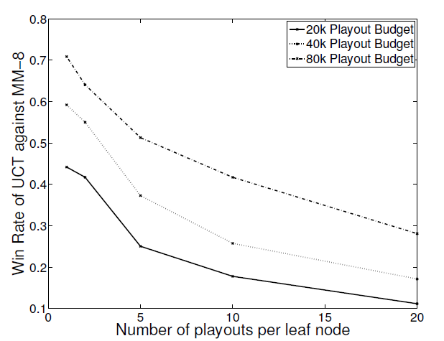
How many samples per leaf is optimal?
a single playout per leaf optimal!
4000 nodes in tree, 5 playouts per node
2000 nodes in tree, 10 playouts per node
It is better to quickly examine many nodes than to get more random
playout samples per node.
Given a fixed budget, should we examine fewer nodes more carefully or more nodes, with each node evaluated less accurately?
Lesson: There is a weak but useful signal in random game playout. *** Single *** sample is enough.

Slide 16
III) Utility estimates backup:
Averaging versus Minimax
UCT uses an averaging strategy to back-up reward values. What about using a minimax backup strategy?
For random playout information (i.e., a very noisy reward signal) averaging is best.
Confirmed on Mancala and with synthetic game tree model.

Slide 17
Aside: Related to “infamous” game tree pathology: Deeper minimax searches can lead to worse performance! (Nau 1982; Pearl 1983).
Phenomenon is related to very noisy heuristics --- such as random playout information.
Minimax uses heuristic estimates only from fringe of the explored tree --- ignoring any heuristic information from internal nodes.
UCT’s averaging over all nodes (including internal ones) can compensate for pathology and near-pathology effects.

Slide 18
Improving over random playout info: Heuristic evaluation
Unlike Go, we do have a good heuristic available for Mancala
  Replace playouts with heuristics: UCT_{H}
Heuristic much less noisy than random playout. Therefore, consider minimax backup.
  We call it UCTMAX_{H}

Slide 19
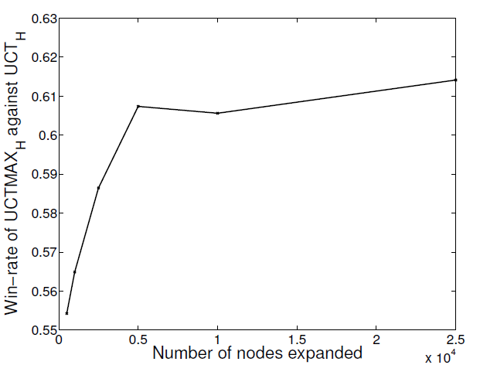
Allow both algorithms to build the same sized trees and compare their win-rates
Lesson: When a state evaluation heuristics is available, use
minimax back-up in conjunction with UCT.

Slide 20
Final step: UCTMAX_{H} versus Minimax
We study the win-rate of UCTMAX_{H} against Minimax players searching to various depths
  Both agents use the same state heuristic
We consider a hybrid strategy
Region with no search traps, play UCTMAX_{H} versus Minimax
X
X
X
X
X
X
X
Region with search traps, play MM-16 versus MM-16
X
X
X
X
X

Slide 21
Mancala:
UCTMAX_{H} vs. Minimax (w. alpha-beta)
Minimax Look-ahead Depth | Win-rate of UCTMAX_{H}
 | 6 Pits, 4 Stones per Pit |  | 8 Pits, 6 Stones per Pit
 | Hybrid |  | Hybrid
k = 6 | 0.76 | 0.72 | 0.71 | 0.68
k = 8 | 0.76 | 0.71 | 0.71 | 0.67
k = 10 | 0.75 | 0.65 | 0.69 | 0.65
k = 12 | 0.67 | 0.61 | 0.66 | 0.61
UCTMAX_{H} hybrid outperforms+ MM
UCTMAX_{H} outperforms MM
Note: exactly same number of nodes expanded.
Difference fully due to exploration / exploitation strategy of UCT

Slide 22
UCT recap:
First head-to-head comparison UCT vs. Minimax and first competitive domain.
Multi-armed bandit inspired game tree exploration is effective.
Random playouts (fully domain-independent) contain weak but useful information. Averaging backup of UCT is the right strategy.
When domain information is available, use UCTMAX_{H .} Outperforms Minimax given exactly the same information and # node expansions.
But, what about Chess?

Slide 23
Chess
What is it about the nature of the Chess search space that makes it so difficult for sampling-style algorithms, such as UCT?
We will look at the role of (shallow) search traps

Slide 24
Search Traps
State at risk
Level-3 search trap for white

Slide 25
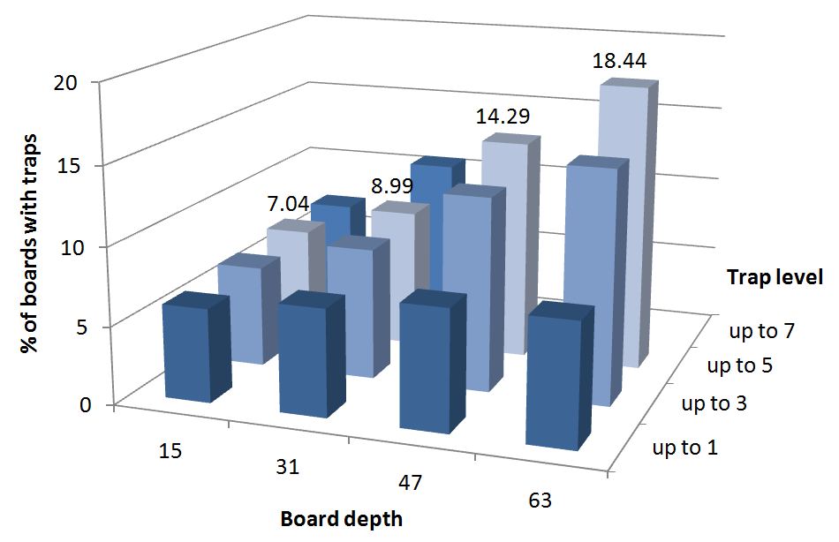
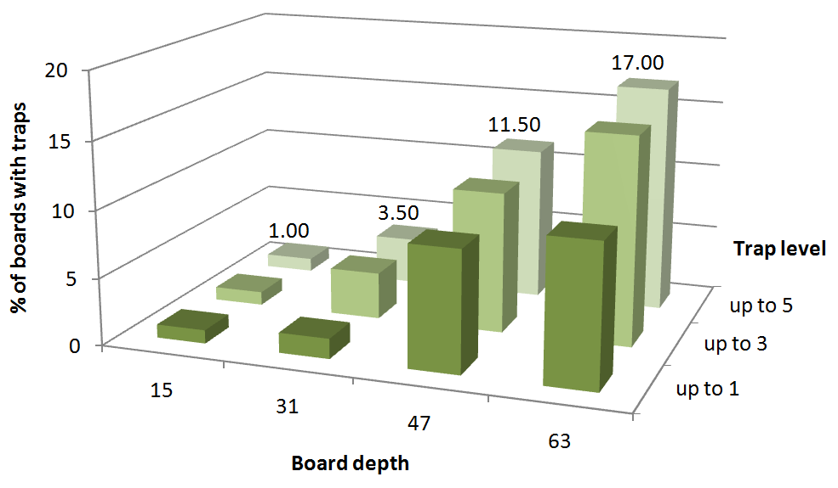
Search Traps in Chess
Random Chess Positions
Positions from GM Games
Search traps in Chess are sprinkled throughout the search space.

Slide 26
Identifying Traps
Given the ubiquity of traps in Chess, how good is UCT at detecting them?
  Run UCT search on states at risk
  Examine the values to which the utilities of the children of the root node converge
  Compare this to the recommendations of a deep Minimax search (the ‘gold-standard’)

Slide 27
Identifying Traps
Utility assigned by UCT to the trap move.
True utility: -1
Utility assigned by UCT to the move deemed best by Minimax
Utility of move that UCT thinks is the best
 | UCT-best | Minimax-best | Trap move
Level-1 trap | -0.083 | -0.092 | -0.250
Level-3 trap | +0.020 | +0.013 | -0.012
Level-5 trap | -0.056 | -0.063 | -0.066
Level-7 trap | +0.011 | +0.009 | +0.004
For very shallow traps, UCT has little trouble distinguishing between good and bad moves
With deeper traps, good and bad moves start looking the same to UCT. UCT will start making fatal mistakes.

Slide 28
UCT conclusions:
Promising alternative to minimax for adversarial search.
Highly domain-independent.
Hybrid strategies needed when search traps are present.
Currently exploring applications to generic reasoning using SAT and QBF.
Also, applications in general optimization and constraint reasoning.
The exploration-exploitation strategy has potential in any branching search setting!

